Slide 1

Екип:
Борислав Иванов
Ива Иванова
Мирослав Сергиев

Slide 2
Съдържание
За играта
Дизайн
Структури от данни и особености в кода
Структура на проекта
Класове и тяхната роля
Source
Заключение

Slide 3
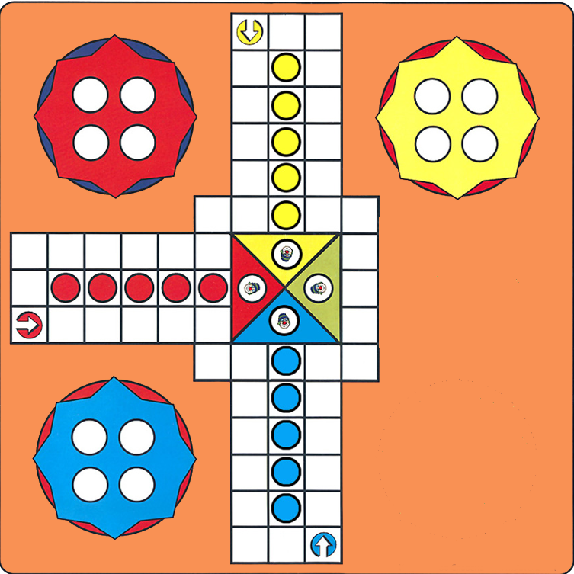
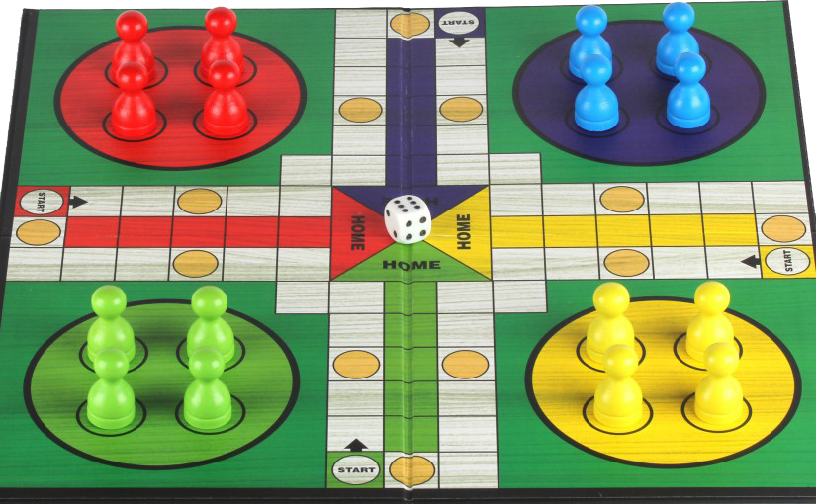
За играта

Slide 4

ДЕМОНСТРАЦИЯ

Slide 5
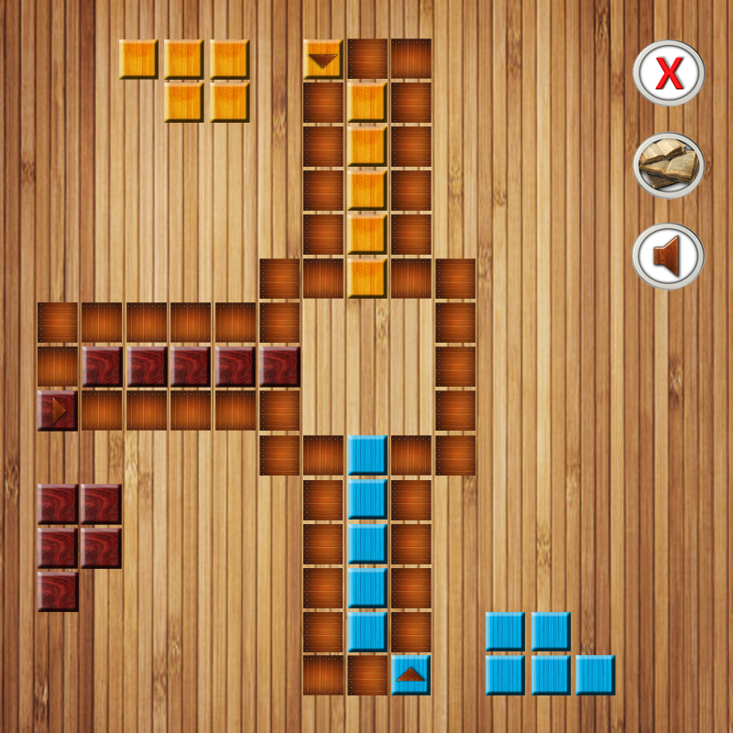


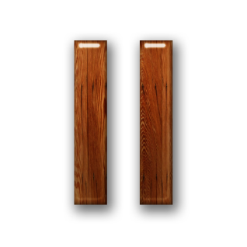

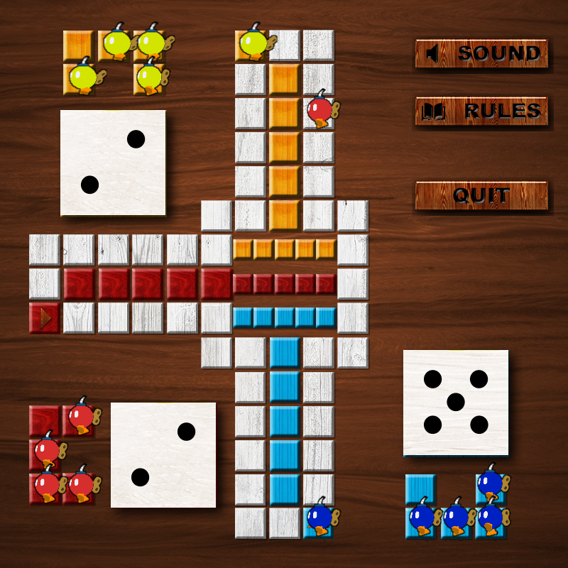

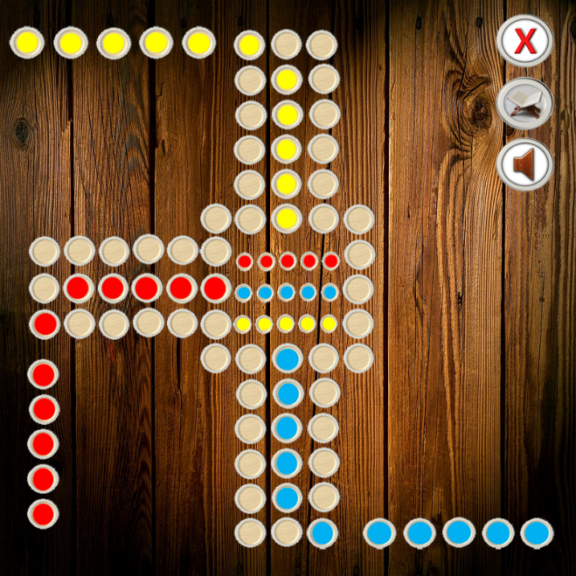
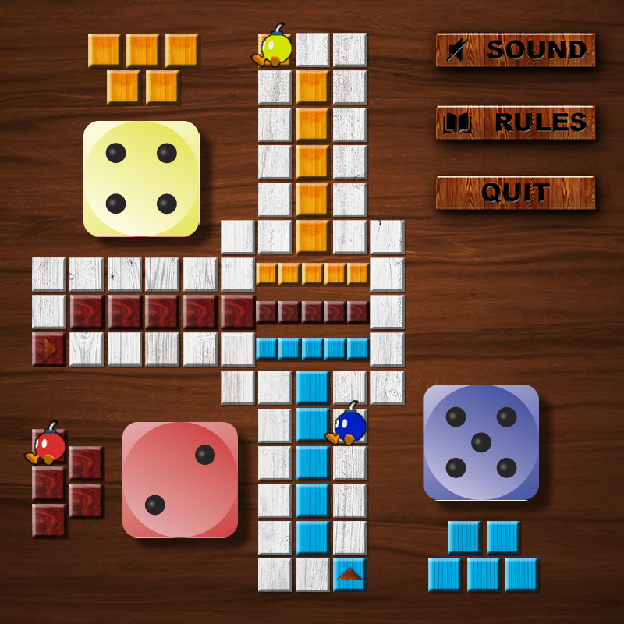
Дизайн
&

Slide 6


Структури от данни и особености в кода
C++ STL
StringStream
{Enum}
PugiXML
SDL
Побитови операции

Slide 7
Структура на кода
TitleScreen
Texture
Static
Recovery
Dice
Controls
Sound
Sprite
Game
RuleScreen
Pawn
Button
Constants
Shared
WinScreen
Player

Slide 8
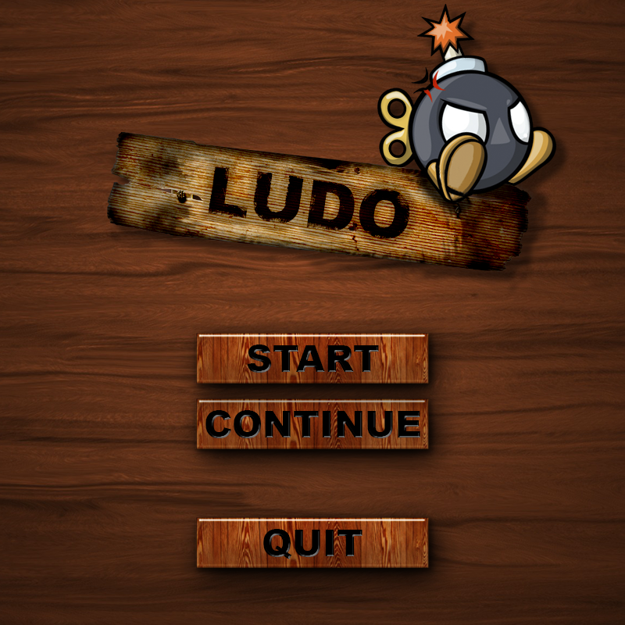
Class: TitleScreen
public:
TitleScreen();
virtual ~TitleScreen();
void init();
virtual void fadeIn();
virtual void fadeOut();
void render();
int eventHandler(SDL_Event& e);
void setContinue(bool canContinue);

Slide 9
Class: Game
public:
Game();
~Game();
void loop();
void setEvent(SDL_Event& event);
void init();
void initGame();
void eventHandler();
void render();

Slide 10
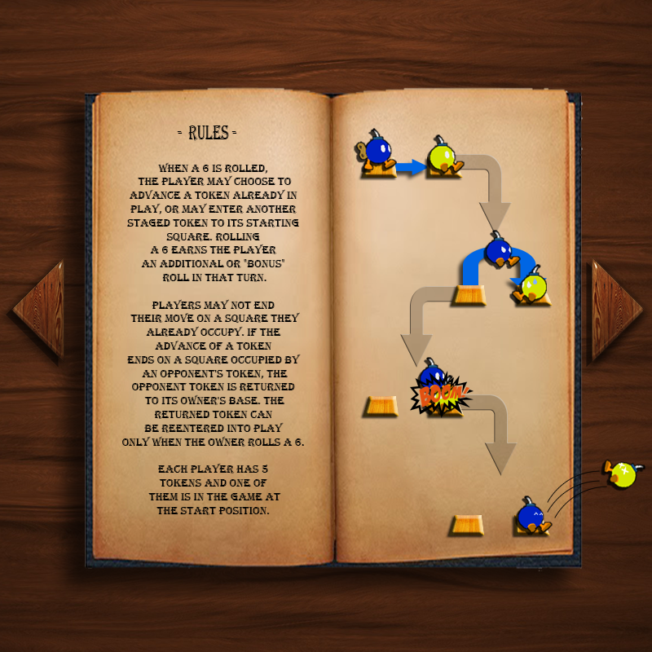
Class: Info
public:
Info();
virtual ~Info();
void init();
void render();
int eventHandler(SDL_Event& e);
virtual void fadeIn();
virtual void fadeOut();
virtual void render();

Slide 11
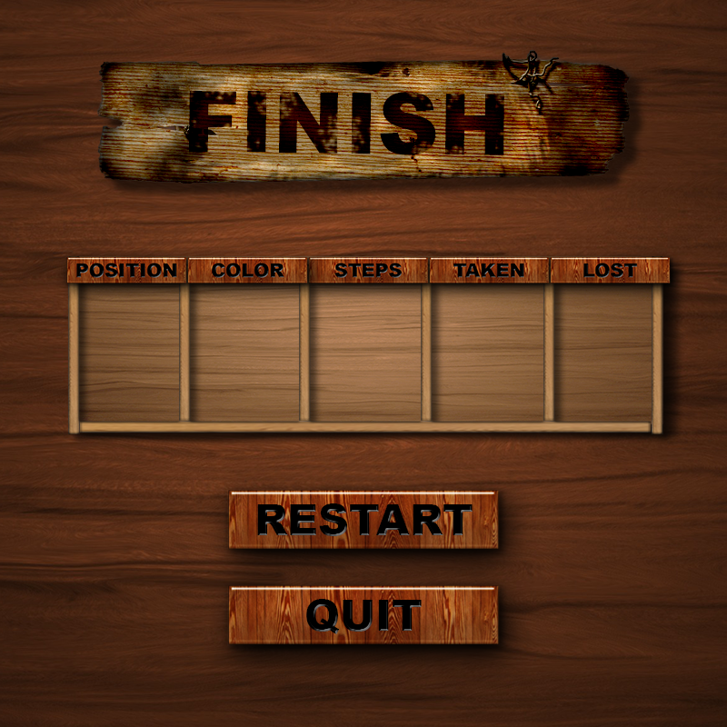
Class: WinScreen
public:
WinScreen();
virtual ~WinScreen();
void init();
virtual void render();
virtual int eventHandler(SDL_Event& e);
virtual void fadeIn();
virtual void fadeOut();
void loadData(deque<Player*>);

Slide 12

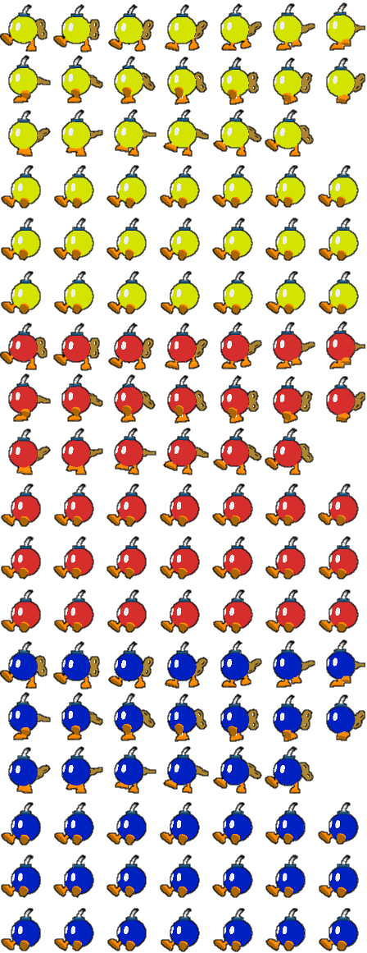

Helper classes: UI, Texture, Button, Sprite
public:
Sprite(SDL_Rect animationFrame, Uint32 numOfFrames = 1, Uint32 animationDelay = 50);
virtual ~Sprite();
void setNumOfFrames(Uint32 numOfFrames);
void setAnimationFrame(SDL_Rect animationFrame);
virtual void render(int x, int y, SDL_Rect* clip = NULL, double a = 0, SDL_Point* c = NULL, SDL_RendererFlip f = SDL_FLIP_NONE);

Slide 13
Class: Player
public:
vector< Pawn* > m_vPawns;
Player(Colors color);
~Player();
void Print();
void Render(vector<pair<int, int>>);

Slide 14
Class: Pawn
Pawn(Colors c);
virtual ~Pawn();
void render(int x, int y);
int getIXPosition() const;
int getIYPosition() const;
double getDScale() const;
bool getBFinished() const;
bool getBIdle() const;
Colors getEColor() const;

Slide 15

Class: Dice
public:
Dice();
virtual ~Dice();
void render();
void setPosition(int x, int y);
void setDiceResult(int DiceResult);
int roll();
bool Event(SDL_Event& e);
void init();

Slide 16


Class: SOUND
public:
Sound();
static bool load();
static void pause();
static bool playing();
static void free();
static void play(SEFFECTS sound);
static void music(MUSIC music);
virtual ~Sound();

Slide 17
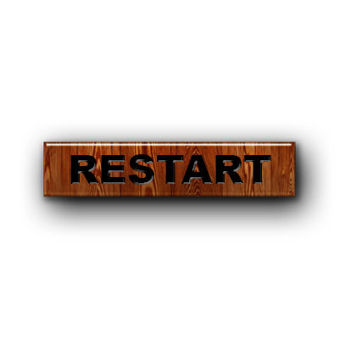

Class: Recovery
public:
Recovery();
virtual ~Recovery();
static deque< Player* > ReadFromXML();
static void WriteXML(deque <Player*>, bool rolled = 0);
static void Print(deque <Player*>);
static bool hasRolled;

Slide 18
Source

Slide 19
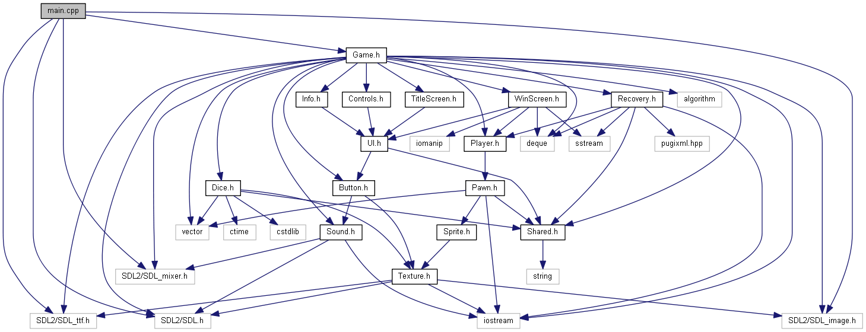
Заключение

Slide 20

Благодарим за вниманието!

